Slide 1
CompTIA Security+ Guide to Network Security Fundamentals, Sixth Edition
Chapter 7
Administering a Secure Network

Slide 2
Objectives
7.1 List and describe the functions of secure network protocols
7.2 Explain the placement of security devices and technologies
7.3 Tell how security data can be analyzed
7.4 Explain how to manage and secure network platforms

Slide 3
Secure Network Protocols (1 of 4)
Protocols
Rules for communication
Essential for proper communication between network devices
Transmission Control Protocol/Internet Protocol (T C P/I P)
Most common protocol suite used for local area networks and the Internet
Comprises several protocols that all function together

Slide 4
Secure Network Protocols (2 of 4)
I P
Protocol that functions primarily at Open Systems Interconnection (O S I) Network Layer (Layer 3)
Provides network addressing and routing
T C P
Transport Layer (Layer 4) protocol
Establishes connections and ensures reliable data transport between devices
T C P/I P uses a four layer architecture
Network Interface, Internet, Transport, Application

Slide 5
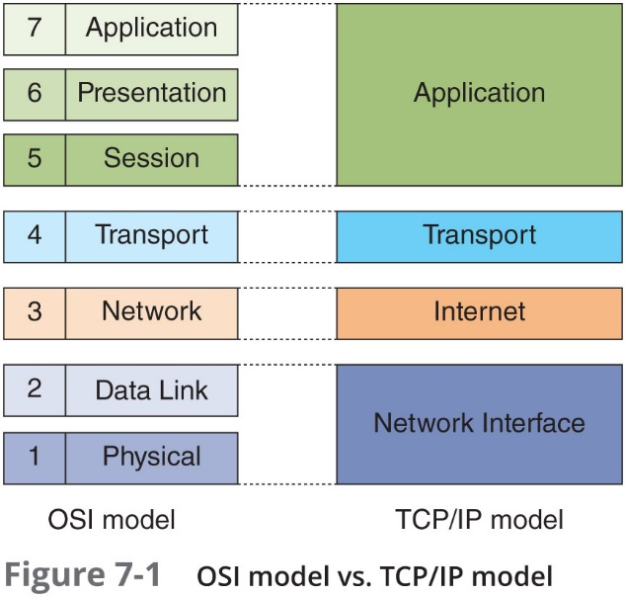
Secure Network Protocols (3 of 4)

Slide 6
Secure Network Protocols (4 of 4)
Several basic T C P/I P Protocols that relate to security:
Simple Network Management Protocol (S N M P)
Domain Name System (D N S)
File Transfer Protocol
There are also email protocols that are not natively secure
Steps can be taken to protect email correspondence

Slide 7
Simple Network Management Protocol (S N M P) (1 of 2)
Used to manage network equipment and is supported by most network equipment manufacturers
Allows administrators to remotely monitor, manage, and configure network devices
Functions by exchanging management information between network devices
Each S N M P-managed device has an agent or a service
Listens for and executes commands

Slide 8
Simple Network Management Protocol (S N M P) (2 of 2)
Agents are password protected
Password is known as a community string
Security vulnerabilities were present in S M N P versions 1 and 2
Version 3 uses usernames and passwords along with encryption to address vulnerabilities

Slide 9
Domain Name System (D N S) (1 of 3)
D N S
A T C P/I P protocol that maps I P addresses to their symbolic name
The D N S database is organized as a hierarchy
Database consists of the name of a site and a corresponding I P number
The database is distributed to many different servers on the Internet
To prevent bottlenecking and to ensure efficiency

Slide 10
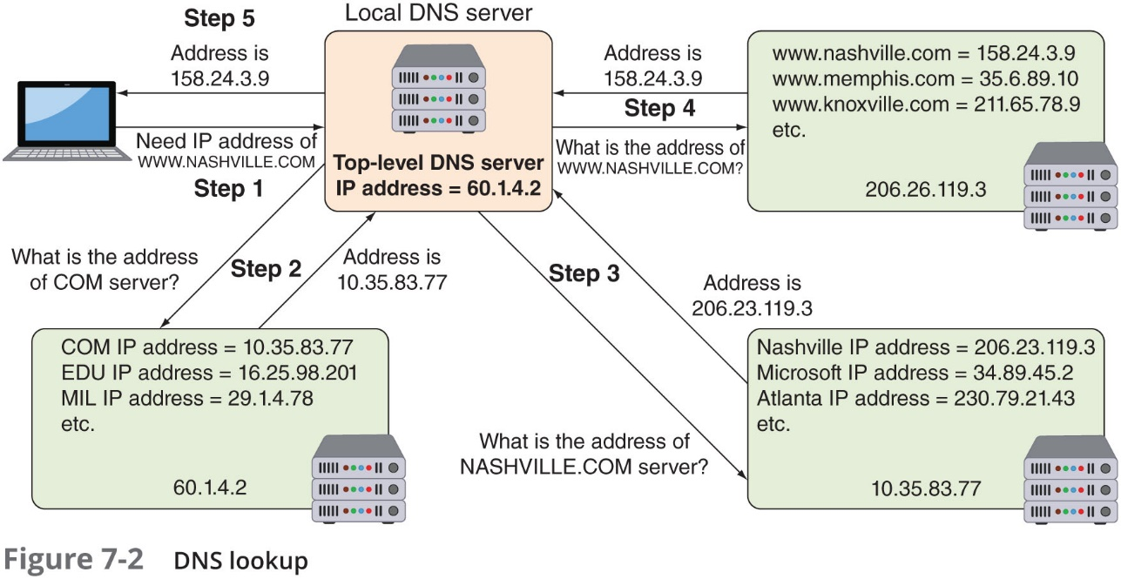
Domain Name System (D N S) (2 of 3)

Slide 11
Domain Name System (D N S) (3 of 3)
D N S is often the focus of attacks
D N S poisoning substitutes fraudulent I P address
Can be done in local host table or external D N S server
Can be thwarted by using Domain Name System Security Extensions (D N S S E C)
D N S S E C adds additional resource records and message header information which can be used to verify the requested data has not been altered in transmission
Attacker asks the valid D N S for a zone transfer
A zone transfer allows attacker access to network, hardware, and operating system information

Slide 12
File Transfer Protocol (F T P) (1 of 4)
T C P/I P protocol used for transferring files
File transfer protocol (F T P) – an unsecure protocol used to connect to an F T P server
Methods for using F T P on local host computer
From a command prompt
Using a web browser
Using an F T P client

Slide 13
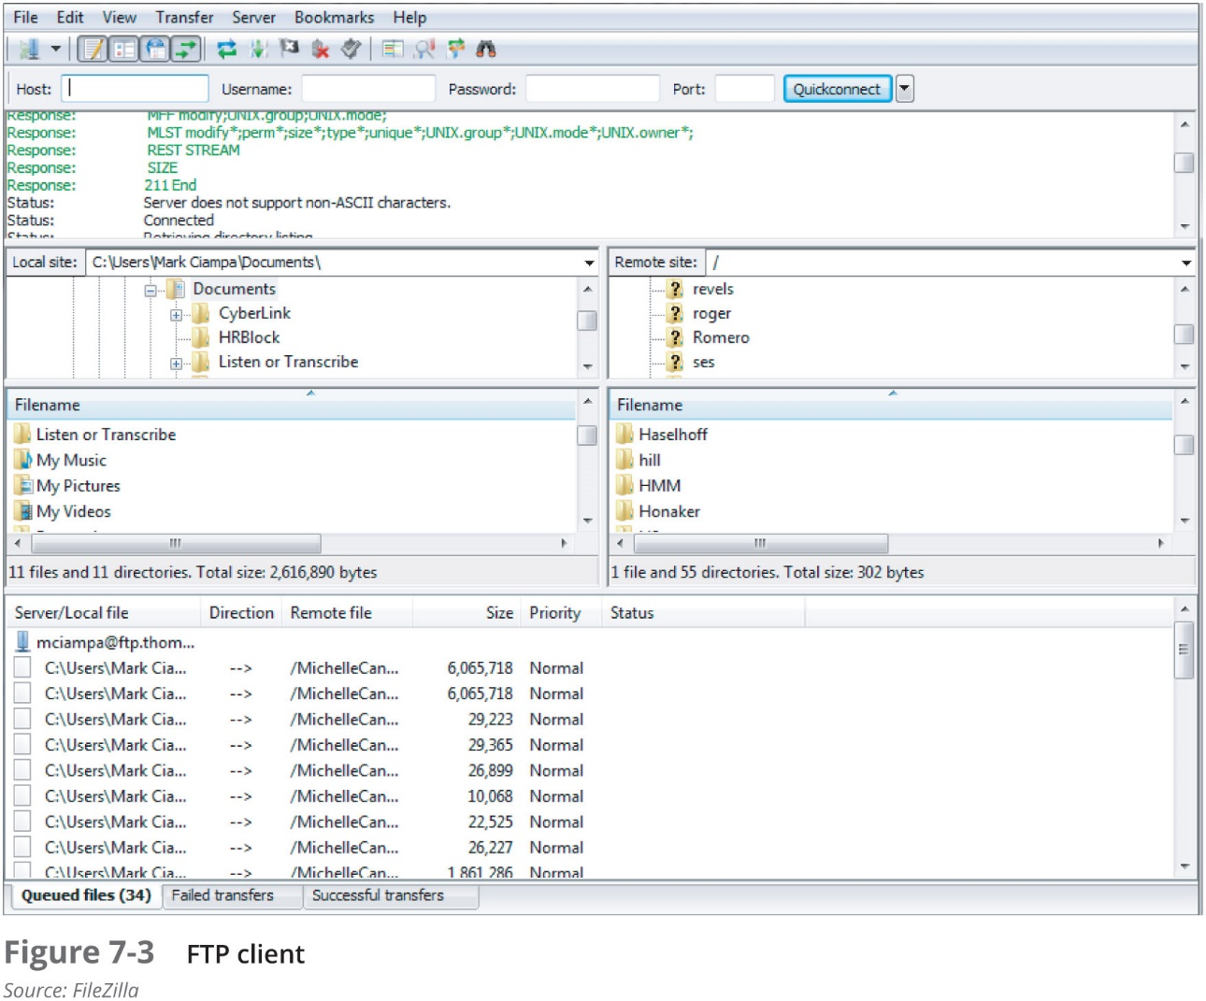
File Transfer Protocol (F T P) (2 of 4)

Slide 14
File Transfer Protocol (F T P) (3 of 4)
Using F T P behind a firewall can present challenges
F T P uses two ports
Port 21 is the F T P control part
Port 20 is the data port
F T P active mode
Client’s firewall may sometimes drop packets on Port 20 (the data channel connection)
F T P passive mode
The client sends a P A S V command to the command channel and the server responds with the T C P port number to use to establish the data channel

Slide 15
File Transfer Protocol (F T P) (4 of 4)
F T P vulnerabilities
Does not use encryption
Files transferred using F T P are vulnerable to man-in-the-middle attacks
Secure transmission options over F T P
Secure sockets layer (F T P S) encrypts commands
Uses S S L or T L S to encrypt commands sent over the control port (port 21); data port may not be encrypted
Secure F T P (S F T P)
Uses only a single T C P port instead of two ports
All data and commands are encrypted

Slide 16
Secure Email Protocols
Secure/Multipurpose Internet Mail Extensions (S/M I M E)
A protocol for securing email messages
S/M I M E has limitations:
Cannot be used when mail is accessed through a web browser instead of a dedicated email application
Because S/M I M E encrypts the entire message, this makes it difficult for any third-party tools that inspect email for malware
Because it also would be encrypted
Some enterprises and government agencies automate encrypting and decrypting email
Use a mail gateway appliance

Slide 17
Using Secure Network Protocols
Application or technology | Recommended secure protocol
Voice and video | Secure Real-time Transport Protocol (S R T P)
Time synchronization | Network Time Protocol (N T P)
Email | Secure/Multipurpose Internet Mail Extensions (S/M I M E)
Web browsing | Hypertext Transport Protocol Secure (H T T P S)
File transfer | Secure F T P (S F T P)
Remote access | Virtual Private Network (V P N)
Domain name resolution | DNS Security Extensions (D N S SEC)
Routing and switching | I P Security (I P sec)
Network address translation | I P Security (I P sec)
Subscription services | I P Security (I P sec)

Slide 18
Placement of Security Devices and Technologies (1 of 5)
The protection that security devices provide can be easily negated if those devices are not properly located in the network architecture
S S L/T L S accelerator – a separate hardware card that inserts into a web server that contains co-processors to handle S S L/T L S processing
a S S L/T L S hardware module can be installed as a “virtual S S L/T L S server” alongside the forward proxy server
Port mirrors – allows the administrator to configure a switch to copy traffic that occurs on some or all ports to a designated port on the switch (see Figure 7-4)
Network tap (test access point) – a device that can monitor traffic (see Figure 7-5)

Slide 19
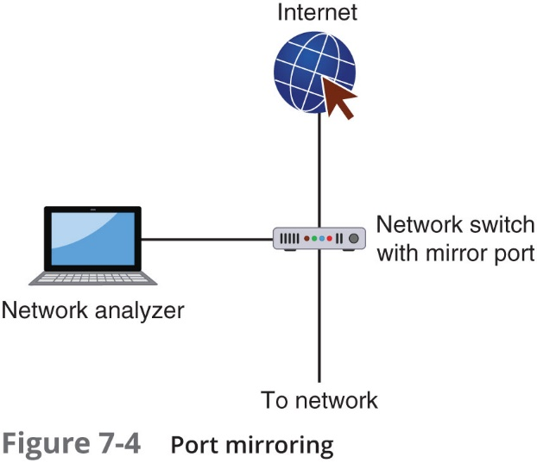
Placement of Security Devices and Technologies (2 of 5)

Slide 20
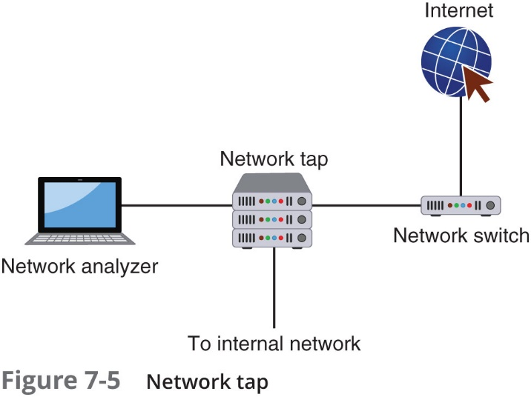
Placement of Security Devices and Technologies (3 of 5)

Slide 21
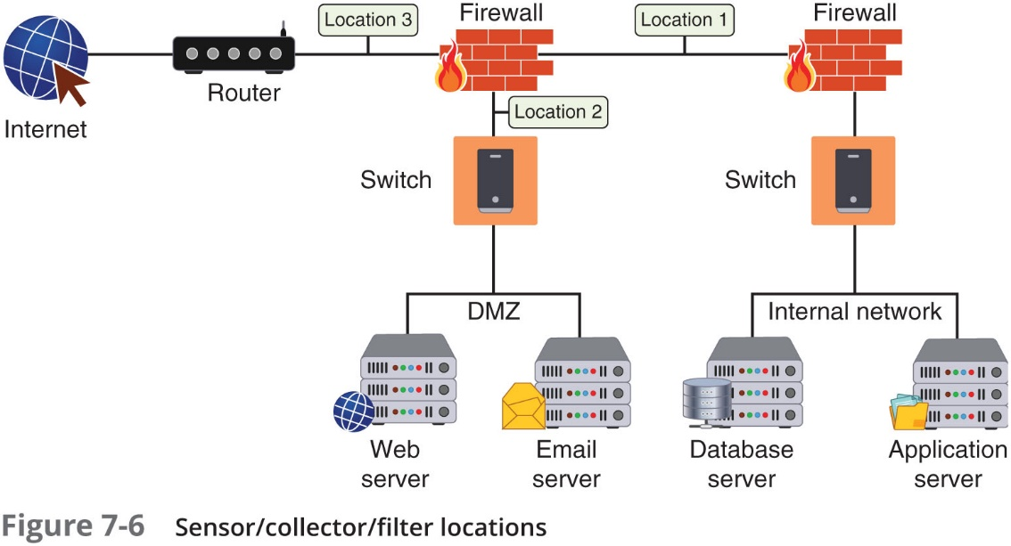
Placement of Security Devices and Technologies (4 of 5)
Sensors, collectors, and filters – should be placed where the stream of data is largest
Sensors – monitor traffic for network intrusion detection and prevention devices
Collectors – gather traffic for S I E M devices
Filters – block traffic for Internet content filters

Slide 22
Placement of Security Devices and Technologies (5 of 5)
Aggregation switch – used to combine multiple network connections into a single link
Should be located between routers and servers where they can detect and stop attacks directed at a server or application
Correlation engine – aggregates and correlates content from different sources to uncover an attack
Should be in the protected internal network using data collected from the logs of different hardware devices
D D o S mitigator – a hardware device that identifies and blocks real-time distributed denial of service (D D o S) attacks
Should be in the network where they can monitor the largest stream of data

Slide 23
Analyzing Security Data (1 of 2)
Security logs
Can reveal types of attacks that are being directed at the network and if attacks were successful
Access logs
Provide details regarding requests for specific files
Audit logs
Used to record which user performed an action
Event logs
Document any unsuccessful events and the most significant successful events

Slide 24
Analyzing Security Data (2 of 2)
A routine review of logs helps to identify:
Security incidents
Policy violations
Fraudulent activity
Operational problems
Logs can be useful for:
Performing auditing analysis
Supporting the organization’s internal investigations
Identifying operational trends and long-term problems
Logs can provide documentation that the organization is complying with laws and regulatory requirements

Slide 25
Data from Security Devices
Almost every hardware device designed for security can generate logs
Firewall log items to be examined
I P addresses rejected and dropped
Probes to ports that have no application services on them
Source-routed packets
Suspicious outbound connections
Unsuccessful logins

Slide 26
Data from Security Software
Security software can produce important data that can be analyzed
Data Execution Prevention (D E P)
A Microsoft Windows feature that prevents attackers from using buffer overflow to execute malware
D E P events and those from similar software can be logged along with the level of severity
File integrity check (F I C)
A service that can monitor any changes made to computer files, such as O S files
These changes can compromise security and indicate a security breach has occurred

Slide 27
Data from Security Tools
Tool | Description | Explanation
Application Whitelisting | A whitelist is an inventory of applications and associated components that have been pre-approved and authorized to be active and present on the device | Application whitelisting technologies are designed to permit only known good activity and block everything else
Removable media control | Removable media control is a tool that can be used to restrict which removable media can be attached to a system | Removable media can introduce malware into a system and be used to steal valuable information
Advanced malware management | Often a third-party service, advanced malware management tools monitor a network for any unusual activity | Advanced malware management tools often use experience-based techniques such as heuristic monitoring to determine if a threat exists

Slide 28
Issues in Analyzing Security Data (1 of 2)
There are issues with log management
Generating, transmitting, storing, analyzing, and disposing of computer security log data
This is due to:
Multiple devices generating logs
Very large volume of data
Different log formats
A solution:
Use a centralized device log analyzer

Slide 29
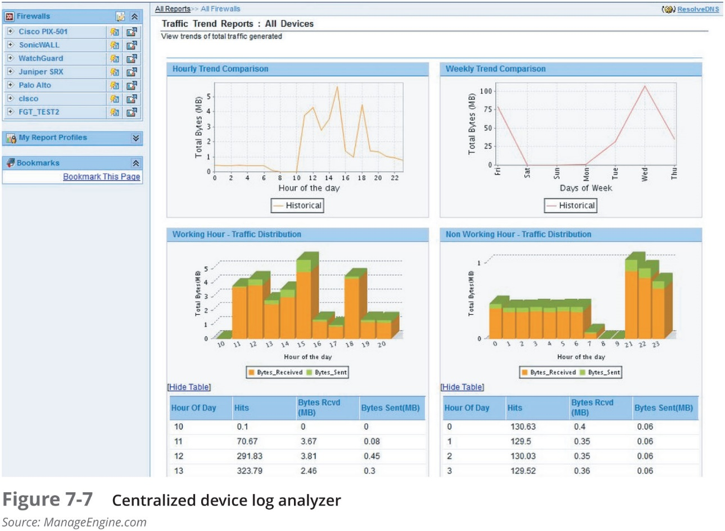
Issues in Analyzing Security Data (2 of 2)

Slide 30
Managing and Securing Network Platforms
Some applications and platforms require special security considerations:
Virtualization
Cloud computing
Software defined networking

Slide 31
Virtualization (1 of 7)
Virtualization
A means of managing and presenting computer resources without regard to physical layout or location
Host virtualization
An entire operating system environment is simulated
Virtual machine - a simulated software-based emulation of a computer
The host system runs a hypervisor that manages the virtual operating systems and supports one or more guest systems

Slide 32
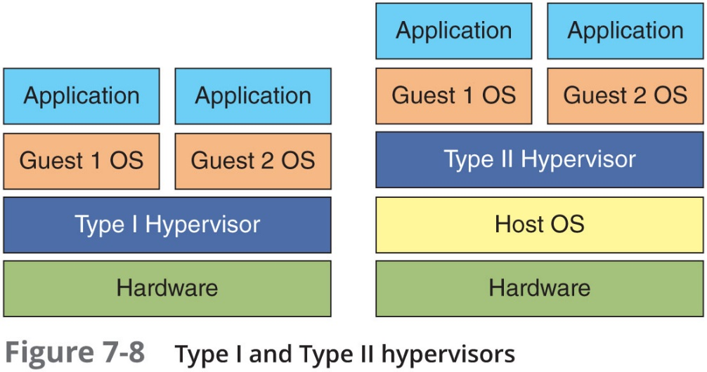
Virtualization (2 of 7)
The VM monitor program is called a hypervisor
Manages the V M operating systems
Two types of hypervisor:
Type I – runs directly on the computer’s hardware instead of the underlying O S
Type II – run on the host O S, much like an application

Slide 33
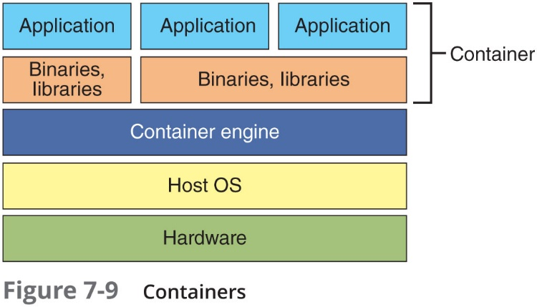
Virtualization (3 of 7)
Container or application cell
Holds only the necessary O S components that are needed for that specific application to run
Reduces the necessary hard drive storage space and R A M needed
Allows for containers to start more quickly because the O S does not have to be started

Slide 34
Virtualization (4 of 7)
Virtual Desktop Infrastructure (V D I)
The process of running a user desktop inside a V M that resides on a server
Enables personalized desktops for each user to be available on any computer or device that can access the server
Allows centralized management of all virtual desktops
Virtual Distributed Ethernet (V D E)
An Ethernet-compliant virtual network that can connect physical computers and/or virtual machines together

Slide 35
Virtualization (5 of 7)
Virtualization advantages
New virtual server machines can be made available (host availability) and resources can easily be expanded or contracted as needed (host elasticity)
Can reduce costs
Fewer physical computers must be purchased and maintained
Can provided uninterrupted server access to users
Supports live migration which allows a virtual machine to be moved to a different physical computer with no impact to users

Slide 36
Virtualization (6 of 7)
Security-related advantages of virtualization:
Test latest security updates by downloading on a virtual machine before installing on production computers
A snapshot of a particular state of a virtual machine can be saved for later use
Testing the existing security configuration (security control testing) can be performed using a simulated network environment
A suspicious program can be loaded into an isolated virtual machine and executed (sandboxing)
If malware, only the virtual machine will be impacted

Slide 37
Virtualization (7 of 7)
Security concerns for virtualized environments:
Not all hypervisors have the necessary security controls to keep out attackers
Existing security tools were designed for single physical servers
VMs must be protected from both outside networks and other V M s on the same physical computer
VMs may be able to “escape” from the contained environment and directly interact with the host O S
Important to have virtual machine escape protection
Virtual machine sprawl
The widespread proliferation of V M s without proper oversight or management

Slide 38
Cloud Computing (1 of 3)
On-premises model
Enterprises in the past purchased all the hardware and software necessary to run the organization
Resulted in spiraling costs
Hosted services
Servers, storage, and the supporting networking infrastructure are shared by multiple enterprises over a remote network connection
Cloud computing
A model for enabling convenient, on-demand network access to a shared pool of configurable computing resources
It is a pay-per-use computing model
Customers pay for only the resources they need

Slide 39
Cloud Computing (2 of 3)
Types of clouds
Public cloud
Community cloud
Private cloud
Hybrid cloud
Four service models in cloud computing:
Software as a Service (S a a S)
Vendor provides access to the vendor’s software applications running on a cloud infrastructure
Platform as a Service (P a a S)
Consumers install and run their own specialized applications on the cloud computing network
Infrastructure as a Service (I a a S)
Vendor allows customers to deploy and run their own software, including O S s and applications
Security as a Service (SEC a a S)
All security services are delivered from the cloud to the enterprise

Slide 40
Cloud Computing (3 of 3)
Cloud computing security challenges
Cloud provider must guarantee means to approve authorized users and deny imposters
Transmissions from the cloud must be protected
Customers’ data must be isolated from other customers
The highest level of application availability and security must be maintained
Cloud access security broker (C A S B)
A set of software tools or services that resides between the enterprises’ on-premises infrastructure and the cloud provider’s infrastructure
Acts as a “gatekeeper”
Ensures that the security policies of the enterprise extend to its data in the cloud

Slide 41
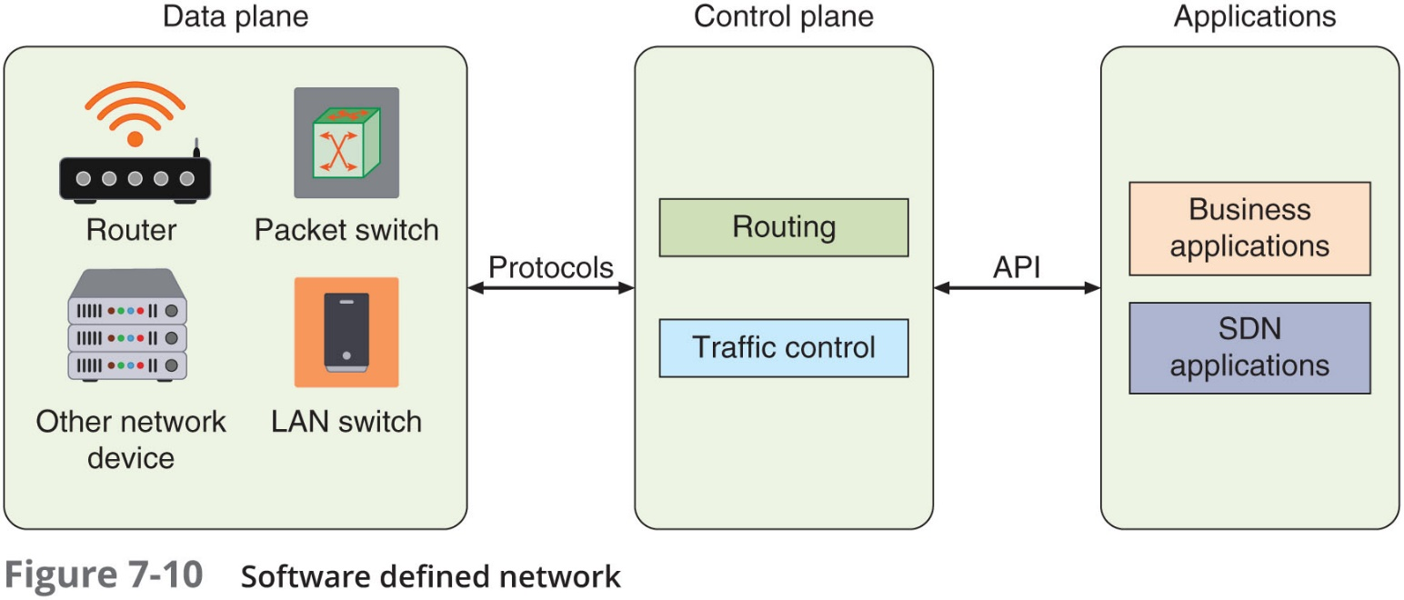
Software Defined Network (S D N) (1 of 2)
Software defined network (S D N)
Virtualizes parts of the physical network so that it can be more quickly and easily reconfigured
Accomplished by separating the control plane from the data plane

Slide 42
Software Defined Network (S D N) (2 of 2)
If traffic needs to flow through the network
It receives permission from the S D N controller, which verifies the communication is permitted by the network policy of the enterprise
Once approved, the S D N controller computes a route for the flow to take
Adds an entry for that flow in each of the switches along the path
S D N s can provide stronger protection
Simplifies extending V LAN beyond the perimeter of the building, which can help secure data
An S D N can ensure that all network traffic is routed through a firewall
Can help capture data for N I D S and N I P S

Slide 43
Review Questions
Which of the following TCP/IP protocols do not relate to security?
A. IP
B. SNMP
C. HTTPS
D. FTP
Catriona needed to monitor network traffic. She did not have the resources to install an additional device on the network. Which of the following solutions would meet her needs?
A. Network tap
B. Port mirroring
C. Aggregation switch
D. Correlation engine
Which of these is the most secure protocol for transferring files?
A. FTPS
B. TCP
C. SFTP
D. FTP

Slide 44
Chapter Summary (1 of 2)
T C P/I P is the most common protocol for LANs and the Internet
Protocols for transferring files
F T P and F T P S
The correct placement of security devices is essential for protection
An S S L/T L S accelerator can be a separate hardware card or a separate S S L/T L S hardware module installed as a “virtual S S L server”
Monitoring traffic on switches can be done in two ways:
A managed switch that supports port mirroring
Install a network tap (test access point)

Slide 45
Chapter Summary (2 of 2)
A log is a record of events that occur
Security logs are particularly important because they can reveal the types of attacks that are being directed at the network
A solution to log management is to use a centralized device log analyzer
Some applications and platforms require special security considerations
Virtualization
Cloud computing
Software defined network (S D N)

